Slide 1
Direct lending fund structures before and after TCJA
Regression Analysis and Plots

Slide 2
Outline
Consider how change in structures for direct lending funds (estimated AUM in 2025 is $1.8 trillion) after TCJA may be shown in IRS data
Structures (pre- and post-TCJA)
IRS data
Hypothesis
Methodology
Findings
Other interesting plots

Slide 3
1. Pre TCJA structure: season-and-sell
Fund principals
ECI-sensitive LPs
UBTI-sensitive LPs
Manager
U.S. taxable LPs
GP
Offshore Feeder (Cayman)
Independent Directors
Interest Income
Onshore Fund (DE)
Offshore Fund (Cayman or DE)
Seasoned loans
Debt
Interest Income
Loans with borrowers
Loans with borrowers

Slide 4
2. Post-TCJA structure: leveraged blocker
Key motivation for the change in structures was the corporate tax rate cut from 35% to 21%. Using a “blocker” to convert business income into investment income was more worthwhile because of the decrease in the tax cost of using an entity subject to corporate tax.
U.S. taxable LPs
ECI-sensitive LPs
UBTI-sensitive LPs
GP
Parallel (Cayman or US)
Main
Equity (High-vote)
Debt
Equity (Low-vote)
Interest Income
U.S. Leveraged Blocker
Interest Income
Origination SPV
Interest Income
Loans with borrowers

Slide 5
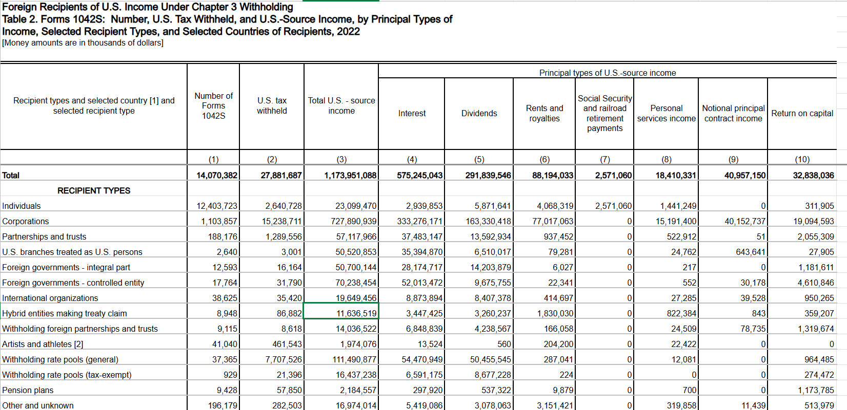
2. IRS Data
IRS publishes data on U.S. source income to foreign recipients. I used data from years 2015 to 2022 (to capture several years before and after TCJA). For each year, the data captures data on payments to different types of entities. SOI tax stats - Foreign recipients of U.S. income statistics | Internal Revenue Service
Entity data: Rows below classify income based on recipient type (individual, corporation, partnership, foreign government, etc.)
Notes:
Unit of observation?

Slide 6
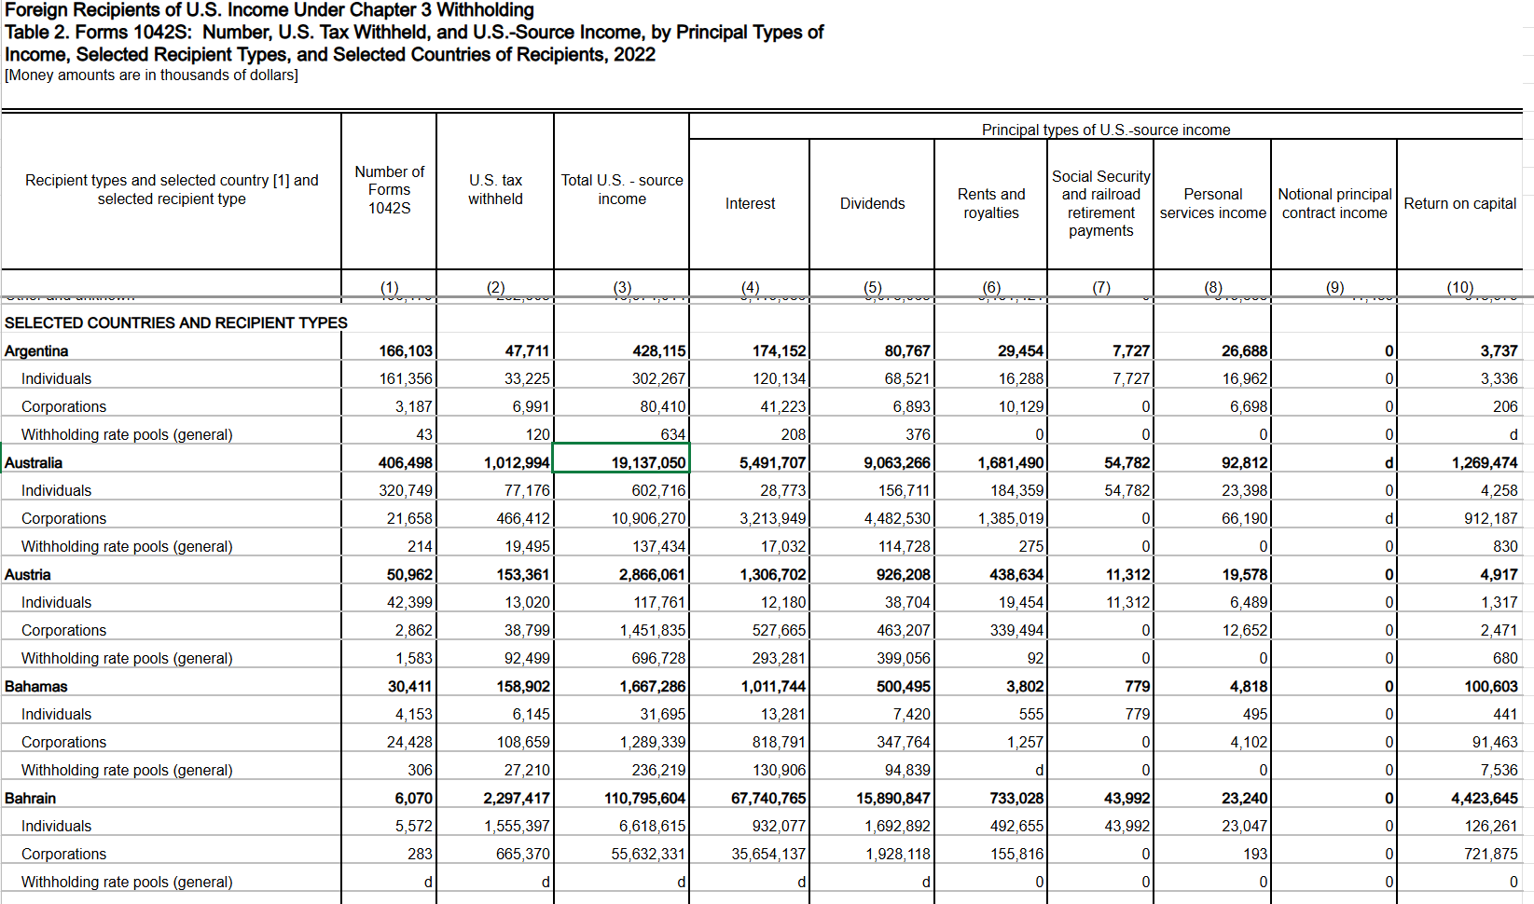
2. IRS Data
Country data: later rows in same excel files per year are classified by country

Slide 7
3. Hypotheses
Interest income
Pre-TCJA, interest income was paid to Cayman entity treated as a corporation for U.S. tax purposes. Post-TCJA, interest income would be paid to a U.S. corporation.
Hypothesis A: using the entity data, interest income paid to foreign corporations would go down after TCJA.
Hypothesis B: using the country data, interest income paid to Cayman corporations would go down after TCJA.
Forms 1042-S
Pre-TCJA, Forms 1042-S would be filed for each borrower paying interest through the fund to the Cayman corporate feeder. Post-TCJA, Forms 1042-S would be filed by U.S. leveraged blocker to each investor in the Cayman partnership feeder.
Hypothesis: If loan size is smaller than investor commitment size, that is, if number of borrowers are more than number of investors, number of forms 1042-S to Cayman entities would decrease after TJCA.

Slide 8
4. Methodology
Difference in differences
Without the ability to do a randomized controlled trial, difference-in-difference regressions can help identify the treatment effect by comparing two variables that would move in parallel in the absence of treatment. Any difference in how the variables move may then signal treatment effect.
Here, we would like to see the effect that the TCJA has on foreign corporations, as compared to the effect on other types of entities; or the effect the TCJA had on number of forms documenting payments made to foreign corporations, as compared to other types of entities.

Slide 9
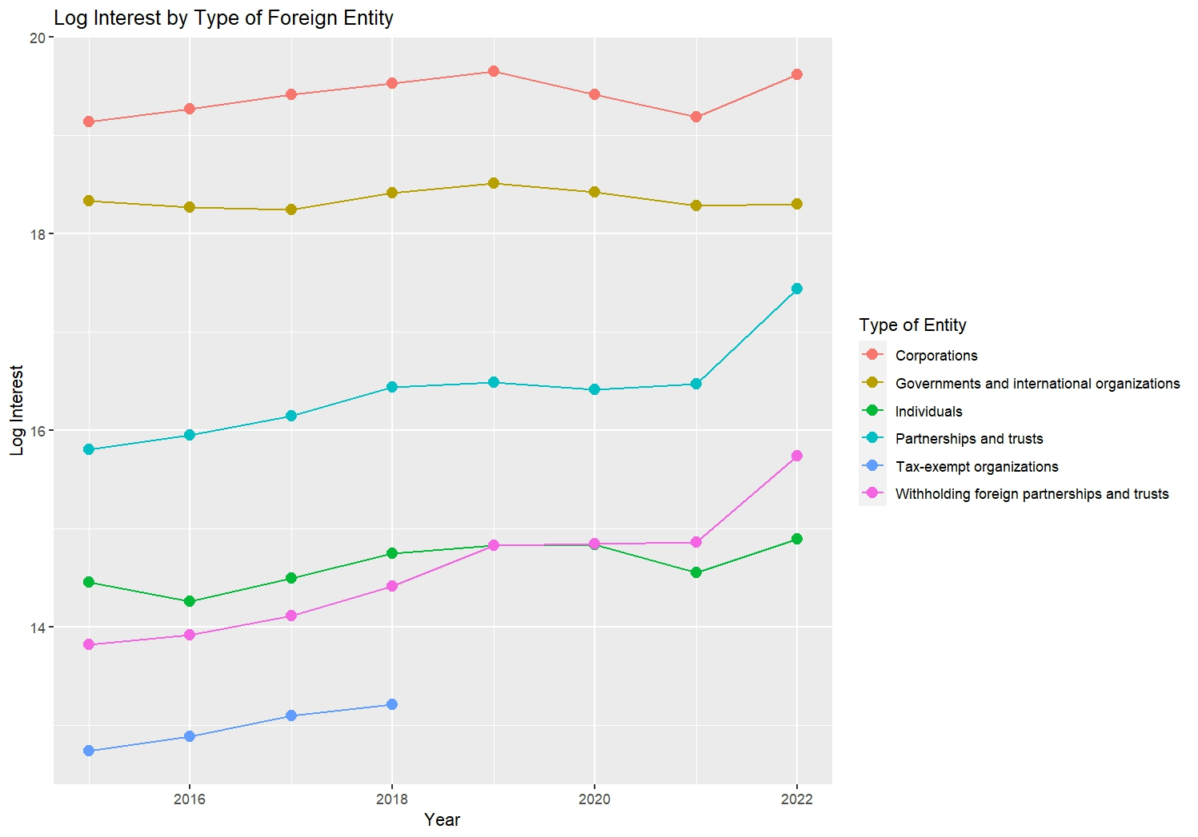
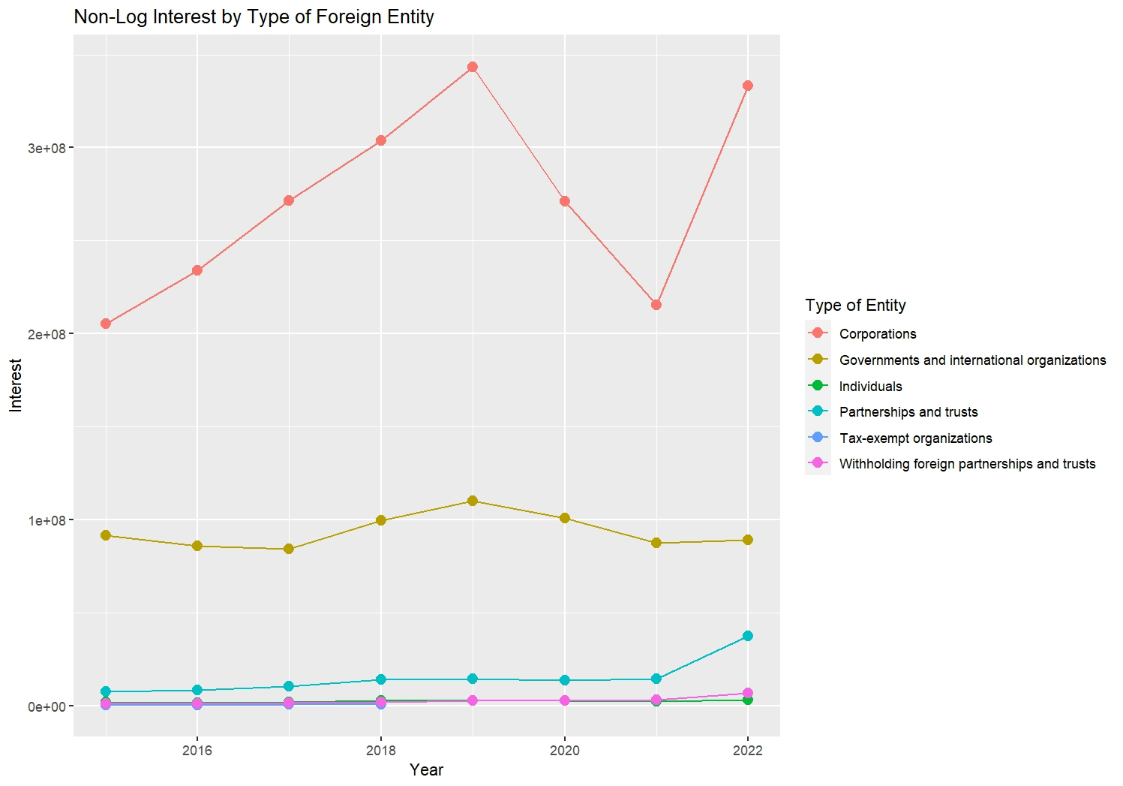
Hypothesis A: Interest income paid to foreign corporations dropped significantly after 2017, but increased in 2022

Slide 10
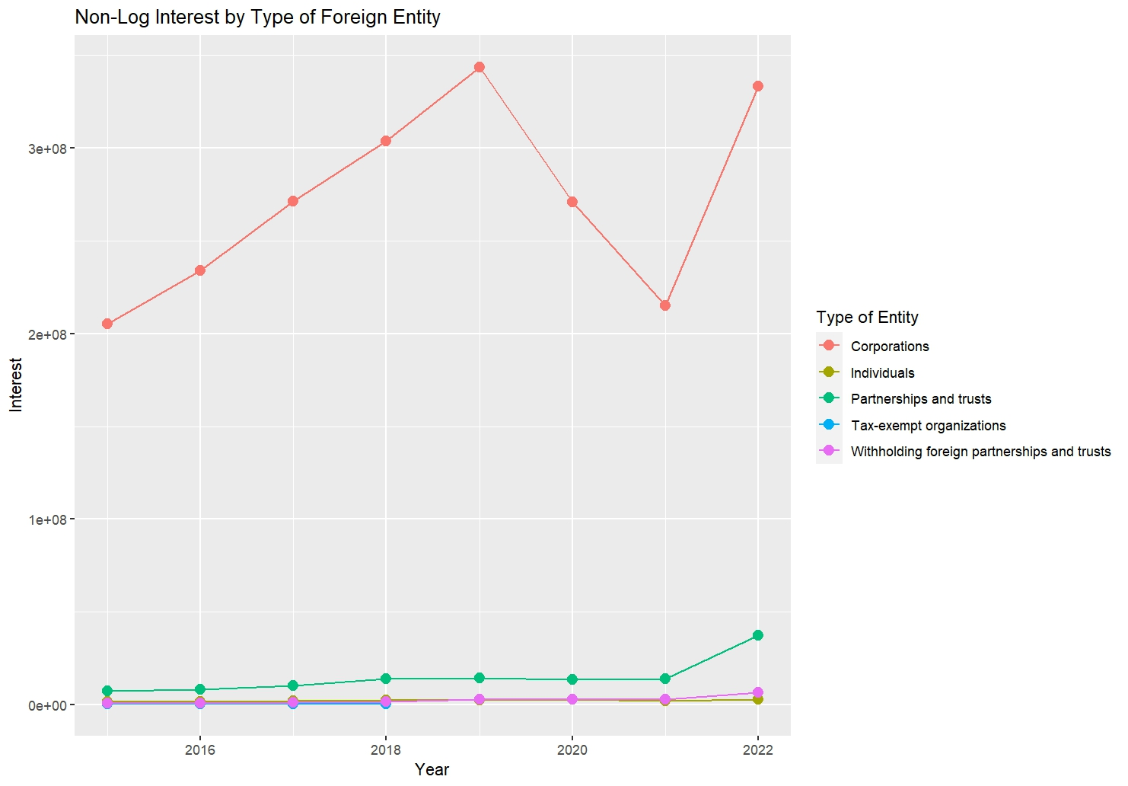
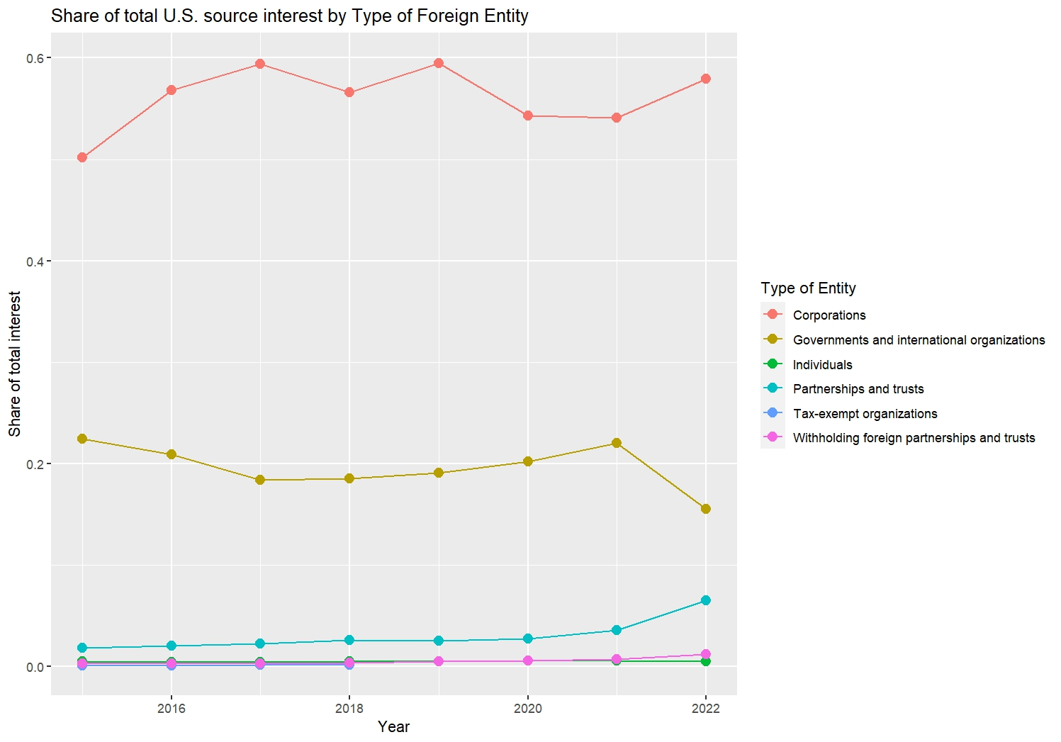
Hypothesis A: Interest income paid to foreign corporations dropped significantly after 2017, but increased in 2022

Slide 11
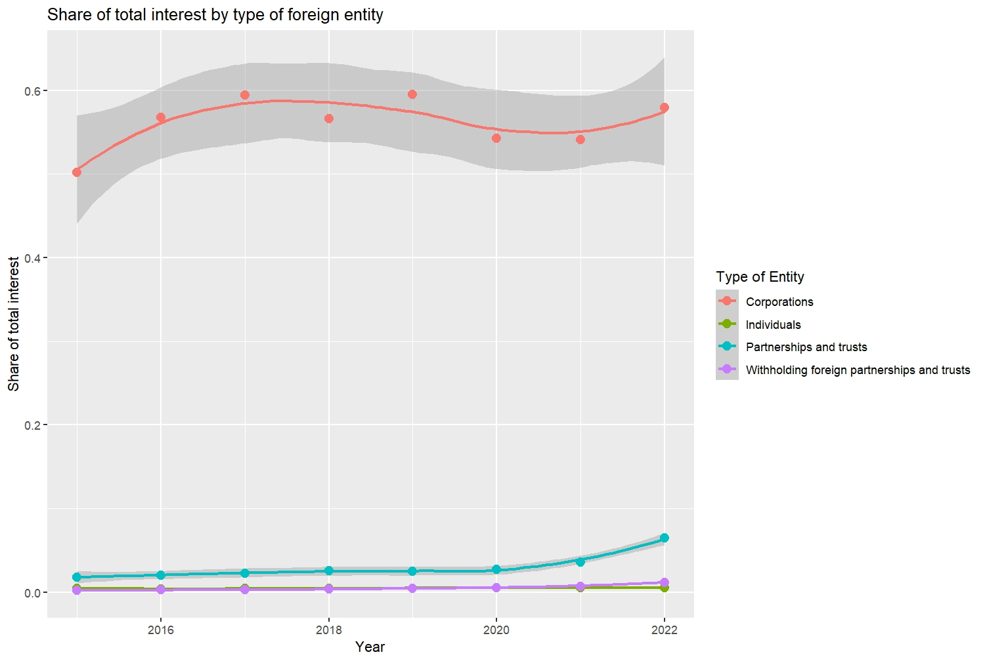
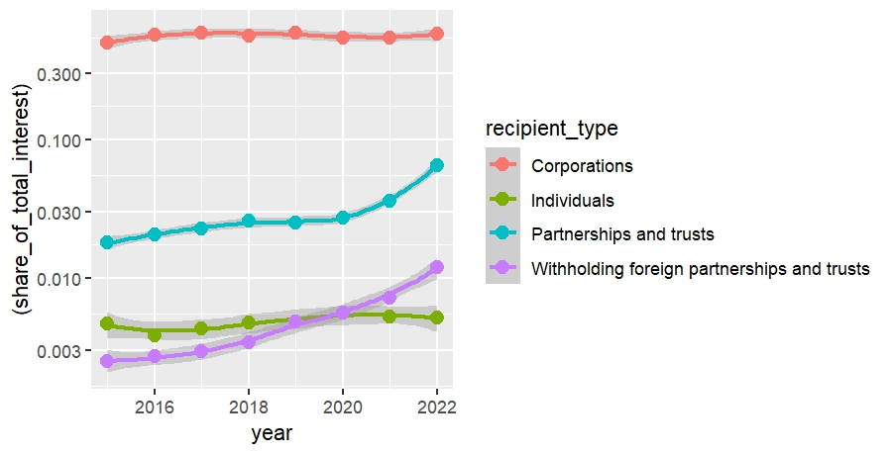
Hypothesis A: Interest income paid to foreign corporations dropped significantly after 2017, but increased in 2022

Slide 12
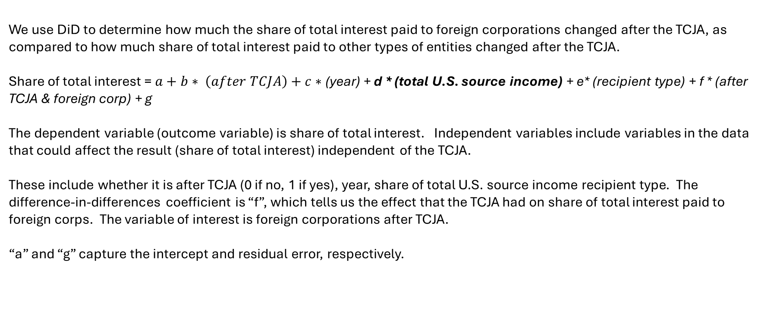
5. Interest Income – Hypothesis A Results
We use DiD to determine how much the share of total interest paid to foreign corporations changed after the TCJA, as compared to how much share of total interest paid to other types of entities changed after the TCJA.
Share of total interest = $a+b∗ \left(after TCJA\right)+c∗$(year) + d * (total U.S. source income) + e* (recipient type) + f * (after TCJA & foreign corp) + g
The dependent variable (outcome variable) is share of total interest. Independent variables include variables in the data that could affect the result (share of total interest) independent of the TCJA.
These include whether it is after TCJA (0 if no, 1 if yes), year, share of total U.S. source income recipient type. The difference-in-differences coefficient is “f”, which tells us the effect that the TCJA had on share of total interest paid to foreign corps. The variable of interest is foreign corporations after TCJA.
“a” and “g” capture the intercept and residual error, respectively.

Slide 13
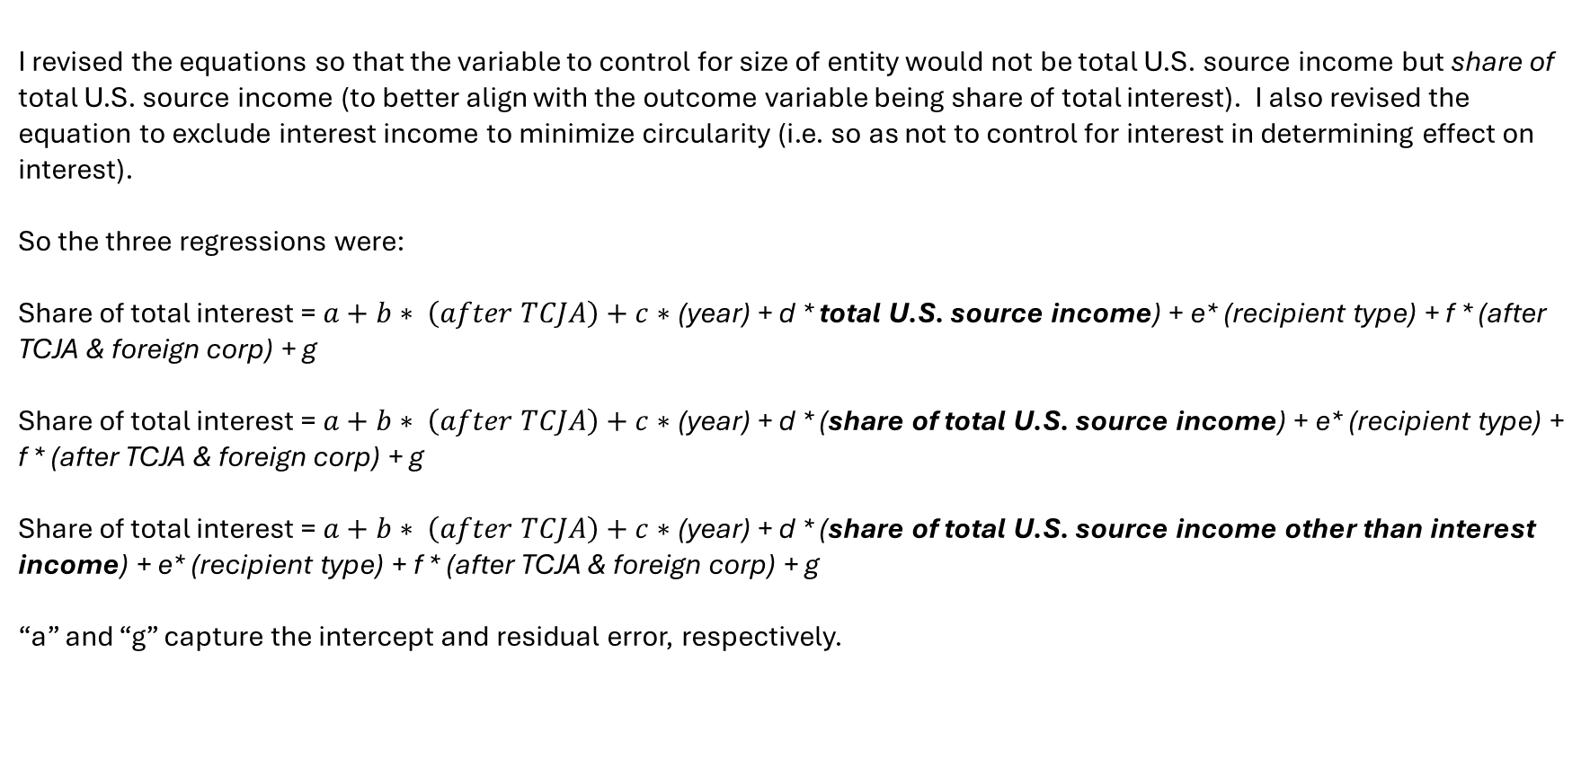
5. Interest Income – Hypothesis A Results
I revised the equations so that the variable to control for size of entity would not be total U.S. source income but share of total U.S. source income (to better align with the outcome variable being share of total interest). I also revised the equation to exclude interest income to minimize circularity (i.e. so as not to control for interest in determining effect on interest).
So the three regressions were:
Share of total interest = $a+b∗ \left(after TCJA\right)+c∗$(year) + d * total U.S. source income) + e* (recipient type) + f * (after TCJA & foreign corp) + g
Share of total interest = $a+b∗ \left(after TCJA\right)+c∗$(year) + d * (share of total U.S. source income) + e* (recipient type) + f * (after TCJA & foreign corp) + g
Share of total interest = $a+b∗ \left(after TCJA\right)+c∗$(year) + d * (share of total U.S. source income other than interest income) + e* (recipient type) + f * (after TCJA & foreign corp) + g
“a” and “g” capture the intercept and residual error, respectively.

Slide 14
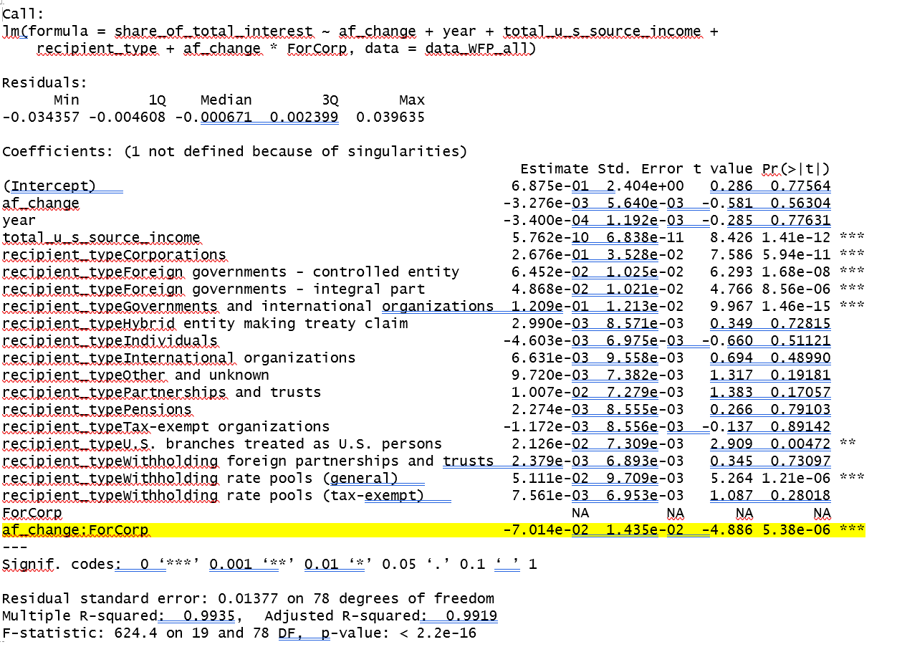
5. Interest Income – Hypothesis A Results
Controlling for total U.S. source income, share of interest paid to foreign corporations (as opposed to other types of entities) decreased significantly after TCJA, by seven percent with statistical significance.
Notes:
“Total U.S. source income” is a poor control. “Share of total U.S. source income” is a better control if the measure is share of total interest.

Slide 15
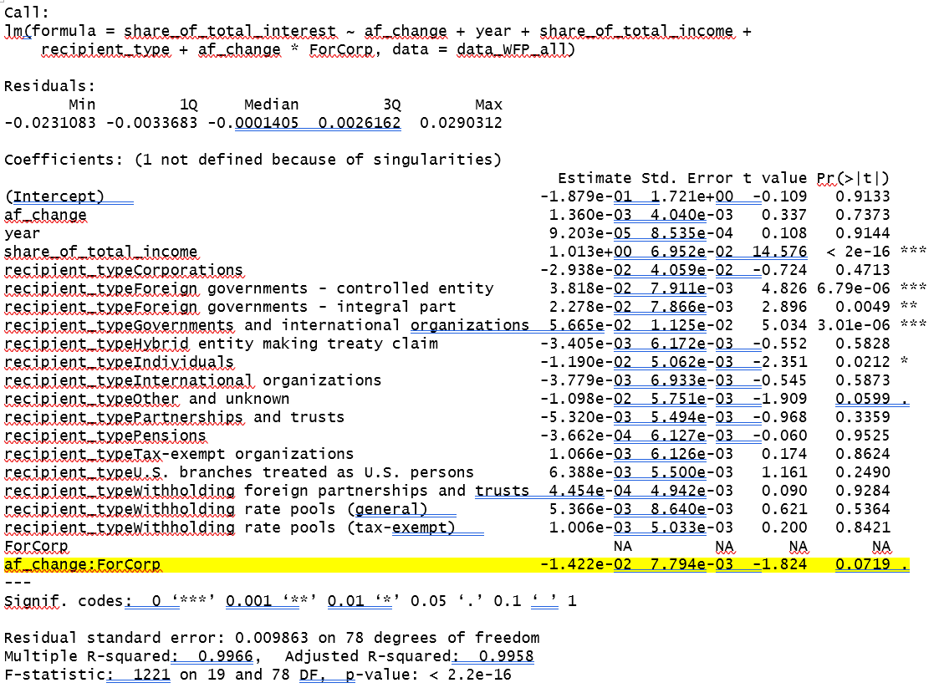
5. Interest Income – Hypothesis A Results
Controlling for share of total U.S. source income, share of interest paid to foreign corporations (as opposed to other types of entities) decreased by 1.4 percent only, with no statistical significance.

Slide 16
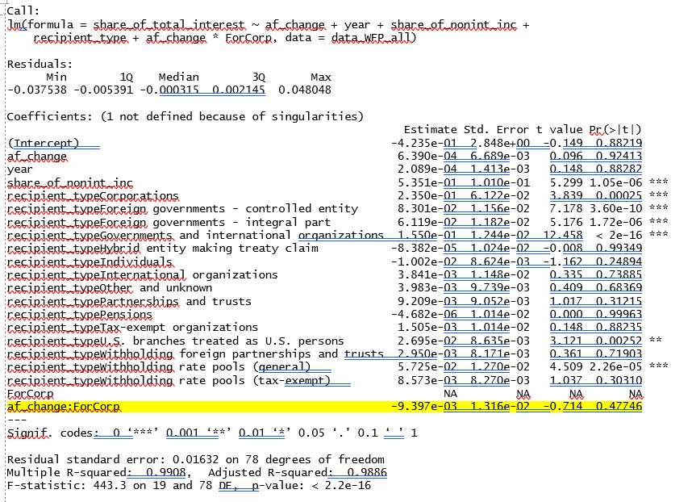
5. Interest Income – Hypothesis A Results
Controlling for share of total non interest income, share of interest paid to foreign corporations (as opposed to other types of entities) decreased by 0.9% only, with no statistical significance.

Slide 17
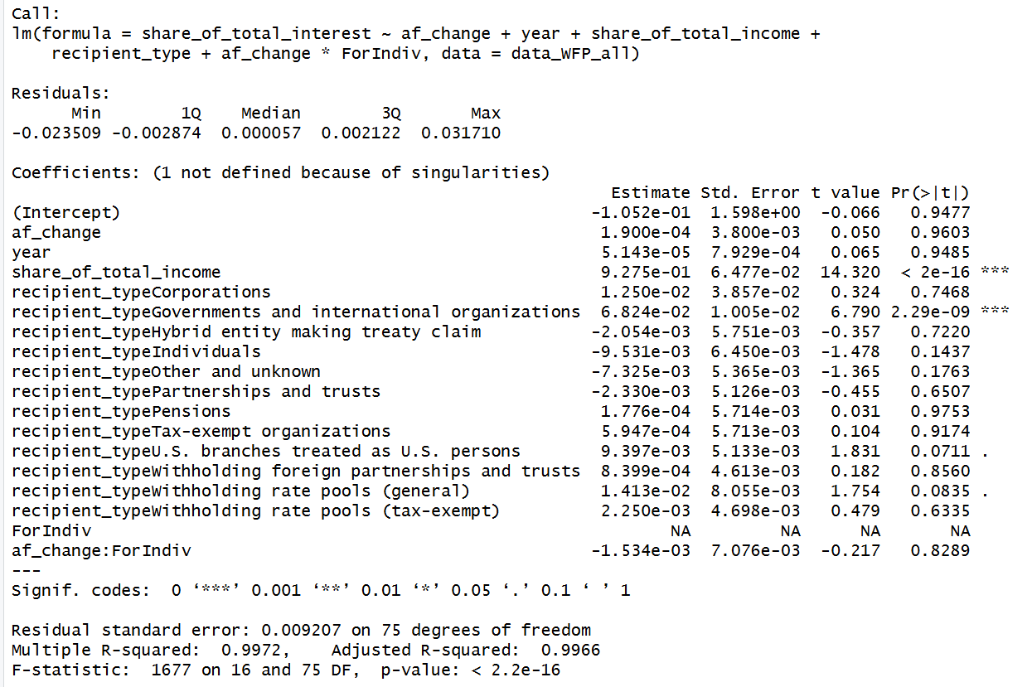
5. Interest Income – Hypothesis A Results
Hypothesis share of interest paid to foreign individuals (as opposed to other types of entities) increased significantly after TCJA – wrong – regression showed a negative, nonsignificant relationship.
Notes:
“Total U.S. source income” is a poor control. “Share of total U.S. source income” is a better control if the measure is share of total interest.

Slide 18
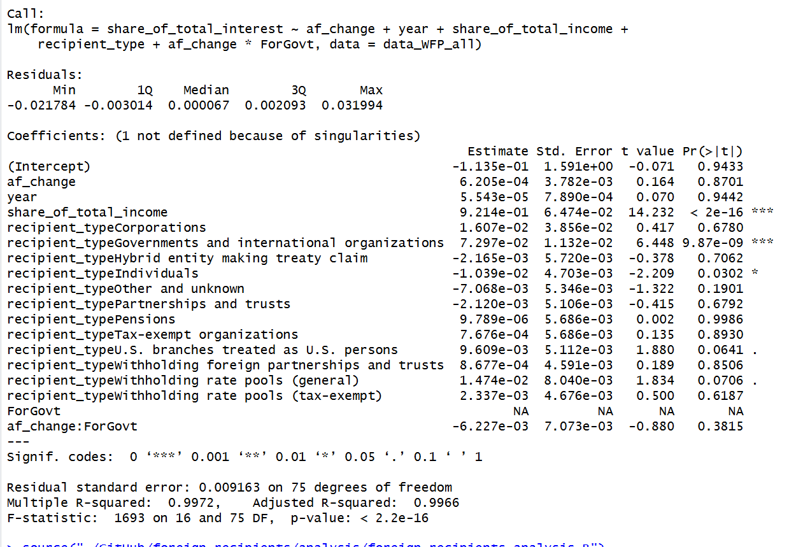
5. Interest Income – Hypothesis A Results
Hypothesis that interest paid to foreign governments (as opposed to other types of entities) increased significantly after TCJA. Also wrong.
Notes:
“Total U.S. source income” is a poor control. “Share of total U.S. source income” is a better control if the measure is share of total interest.

Slide 19
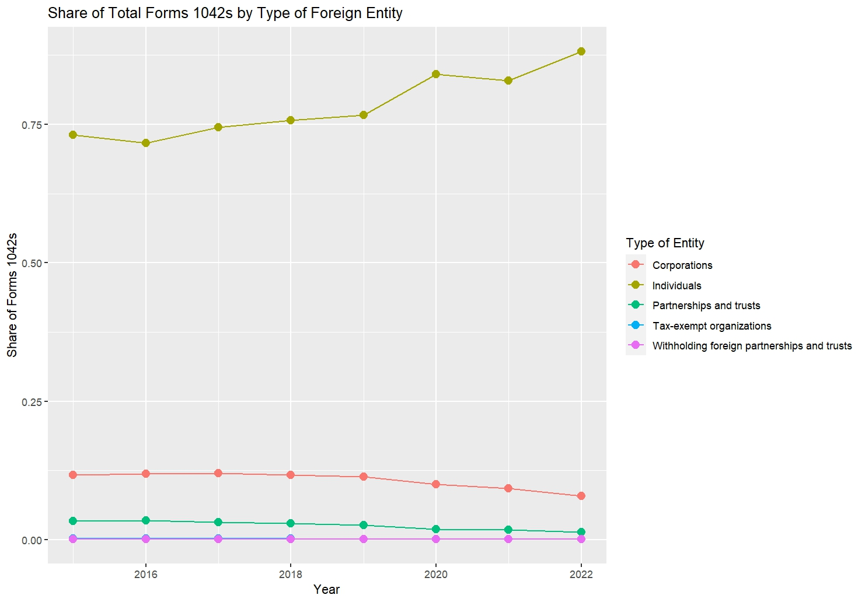
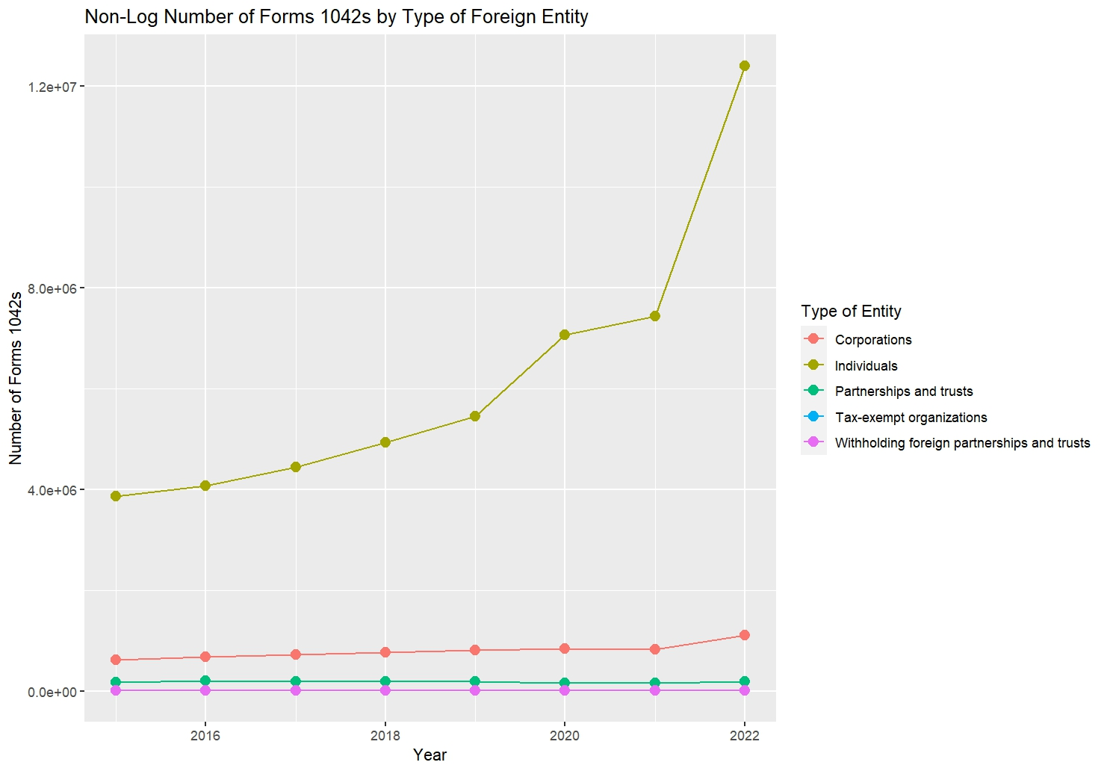
Hypothesis: Share of Forms 1042s to Foreign Corporations Decreased after TCJA

Slide 20
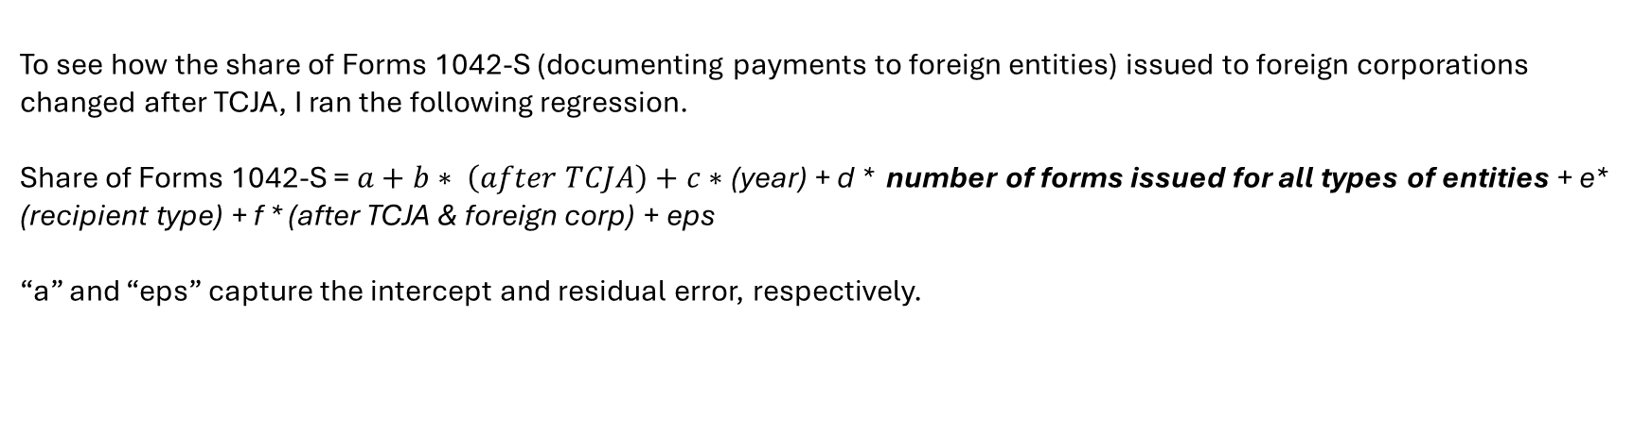
Results
To see how the share of Forms 1042-S (documenting payments to foreign entities) issued to foreign corporations changed after TCJA, I ran the following regression.
Share of Forms 1042-S = $a+b∗ \left(after TCJA\right)+c∗$(year) + d * number of forms issued for all types of entities + e* (recipient type) + f * (after TCJA & foreign corp) + eps
“a” and “eps” capture the intercept and residual error, respectively.

Slide 21
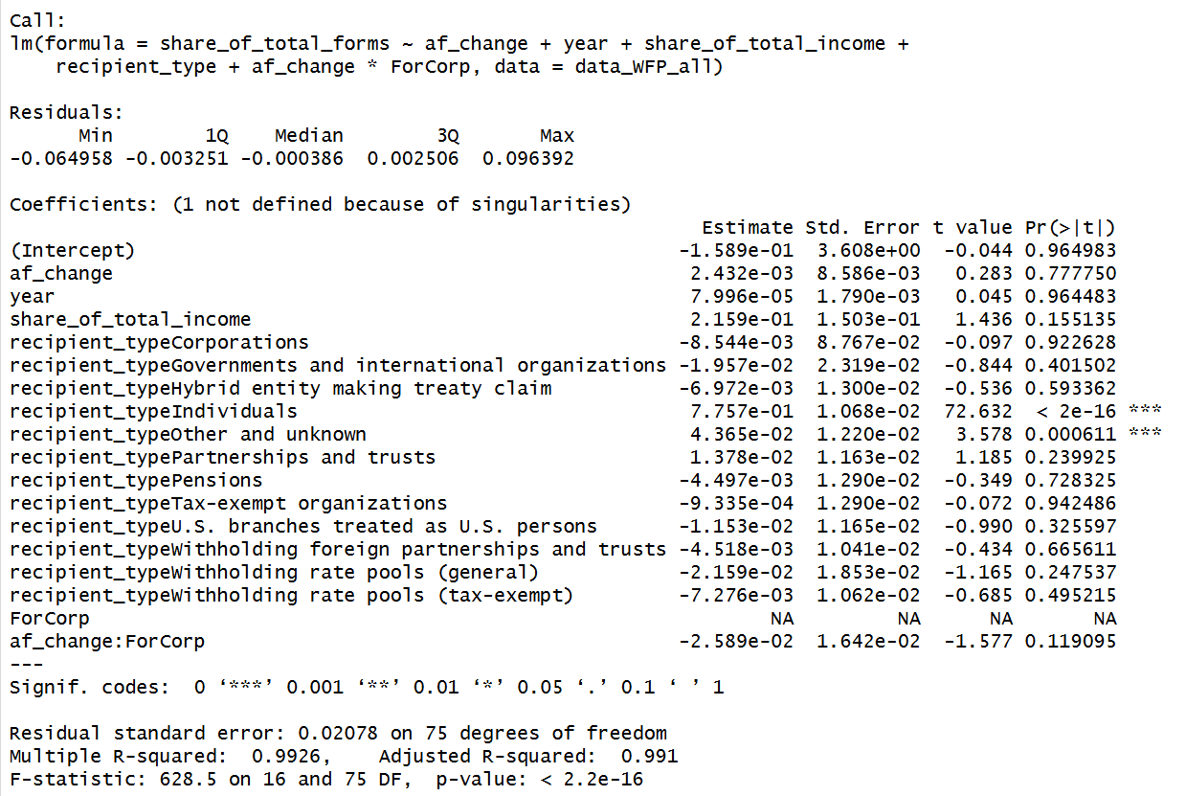
Results
Controlling for share of total U.S. source income, share of forms issued to foreign corporations (as opposed to other types of entities) decreased by 2.6 percent.

Slide 22
Hypothesis C: Interest Income to Tax-Exempt Entities would Increase after TCJA

Slide 23
Hypothesis B Results
Controlling for share of total U.S. source income, share of forms issued to foreign corporations (as opposed to other types of entities) decreased by 2.6 percent.

Slide 24
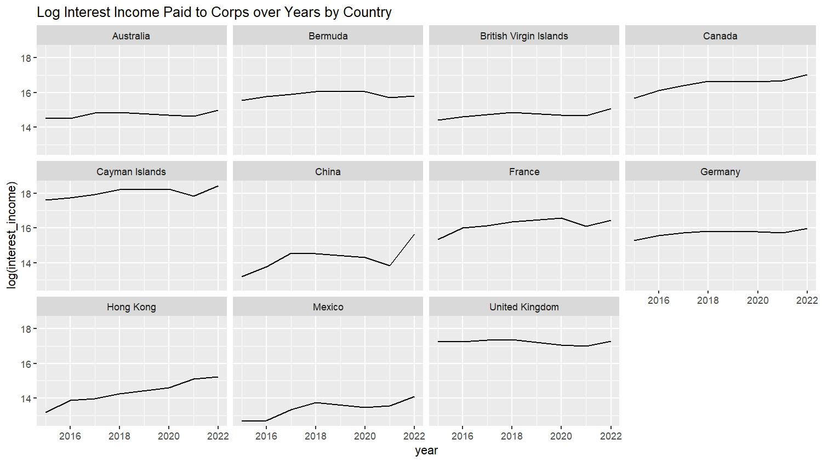
Hypothesis B Cayman receives most of the U.S. source interest payments

Slide 25
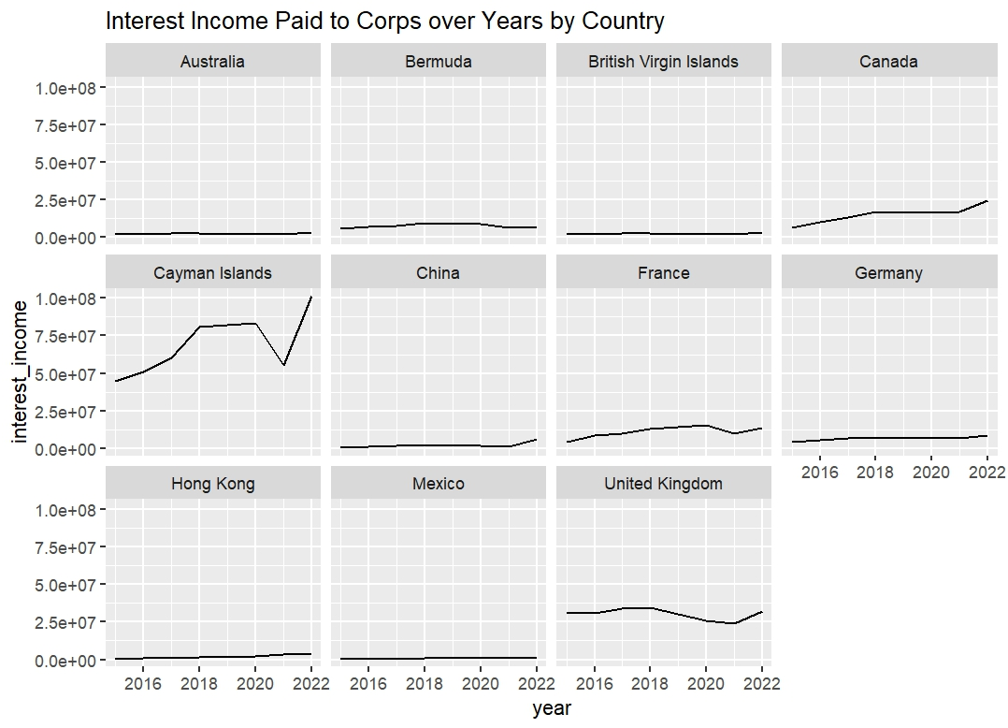
Hypothesis B Cayman receives most of the U.S. source interest payments

Slide 26
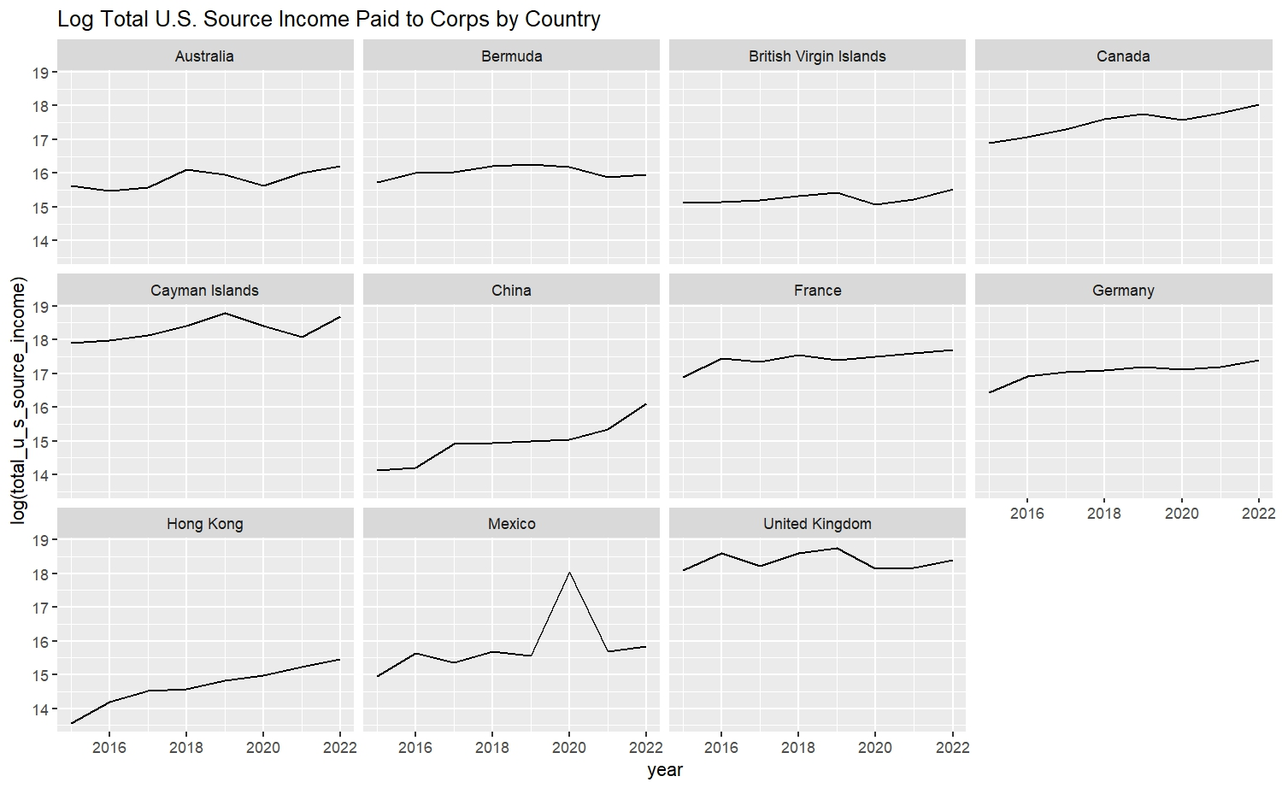
Hypothesis B Cayman receives the largest share of total U.S. payments

Slide 27
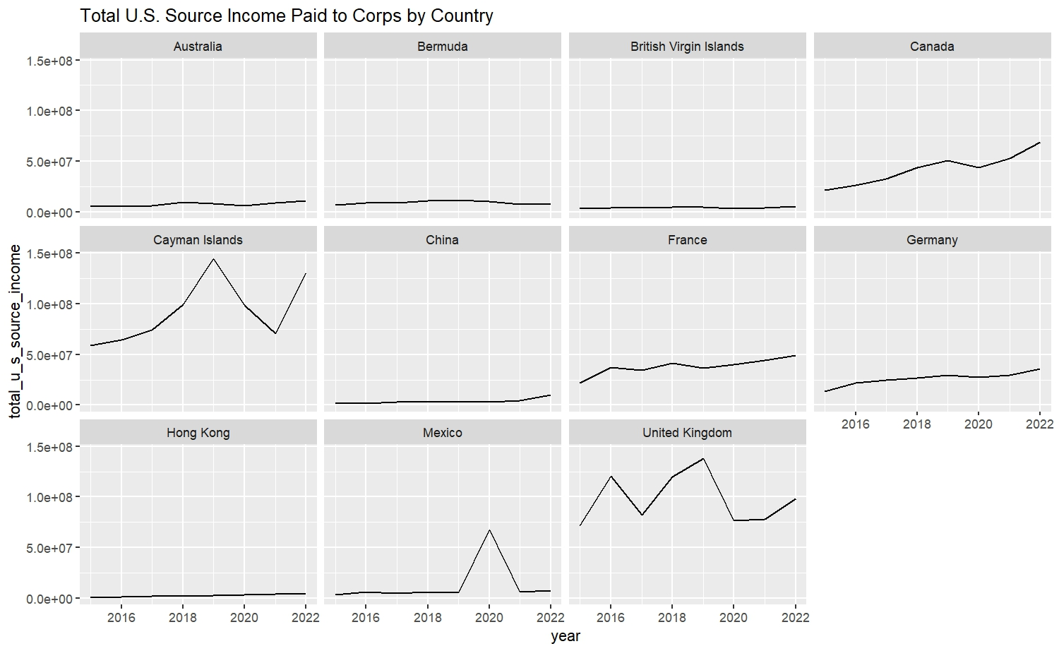
Hypothesis B Cayman receives the largest share of total U.S. payments
Notes:
To do: fix IRS categories, fix share of total income

Slide 28
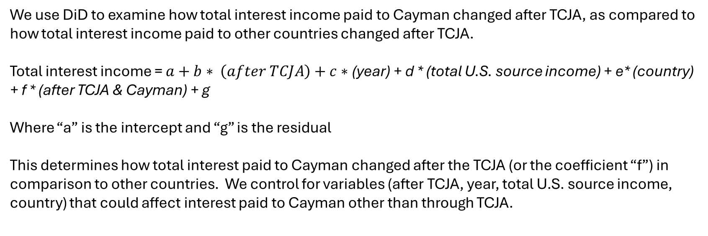
5. Interest Income – Hypothesis B Results
We use DiD to examine how total interest income paid to Cayman changed after TCJA, as compared to how total interest income paid to other countries changed after TCJA.
Total interest income = $a+b∗ \left(after TCJA\right)+c∗$(year) + d * (total U.S. source income) + e* (country) + f * (after TCJA & Cayman) + g
Where “a” is the intercept and “g” is the residual
This determines how total interest paid to Cayman changed after the TCJA (or the coefficient “f”) in comparison to other countries. We control for variables (after TCJA, year, total U.S. source income, country) that could affect interest paid to Cayman other than through TCJA.

Slide 29
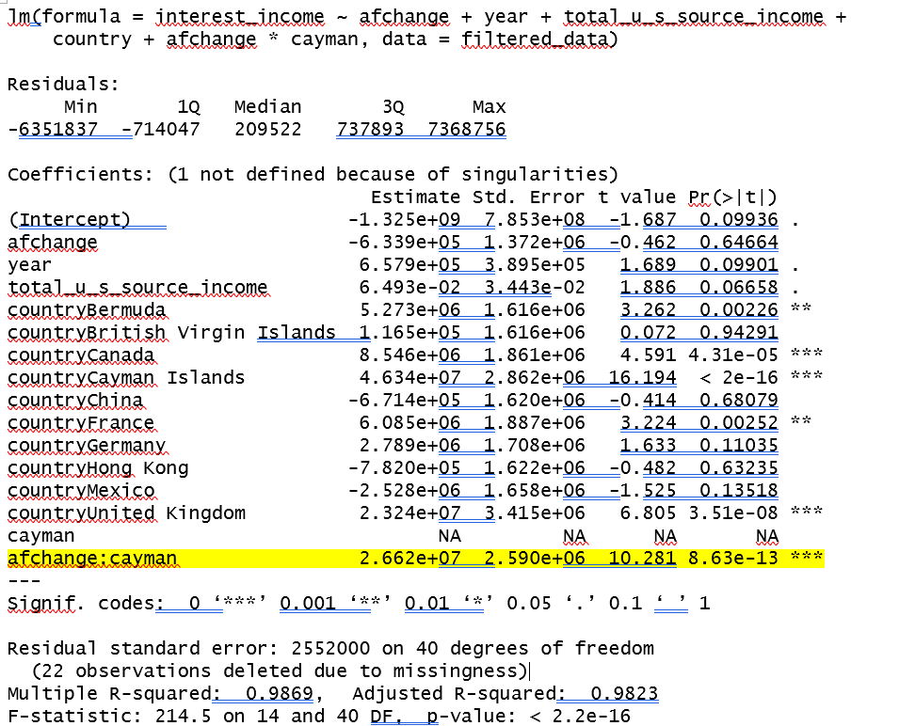
5. Interest Income – Hypothesis B Results
Using country data, interest income to Cayman entities increased after TCJA with statistical significance. However:
Entities may include both corporations and partnerships, which would not say anything about the hypothesis that Cayman corporations would receive lesser amounts of interest income

Slide 30
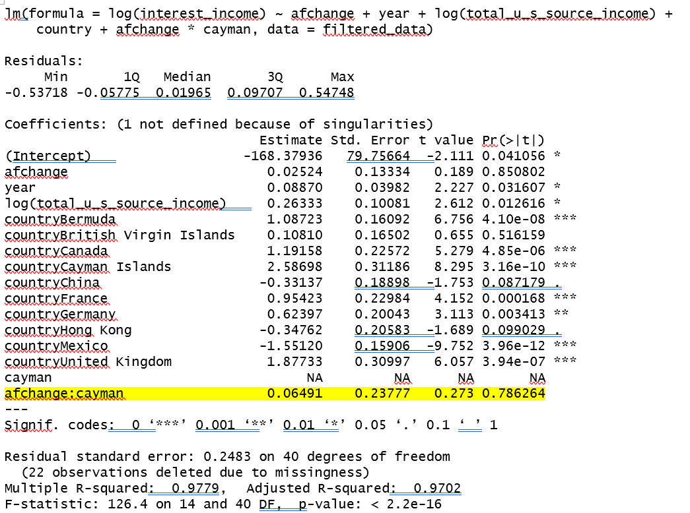
5. Interest Income – Hypothesis B Results
Using country data, statistical significance disappeared when the regression used log measures instead. Log measures percentage changes rather than absolute changes. So, because Cayman receives a disproportionately large amount of interest income as compared to other countries, absolute changes would be larger for Cayman. To be able to see a jump in relative changes, using log may be a more targeted approach.

Slide 31
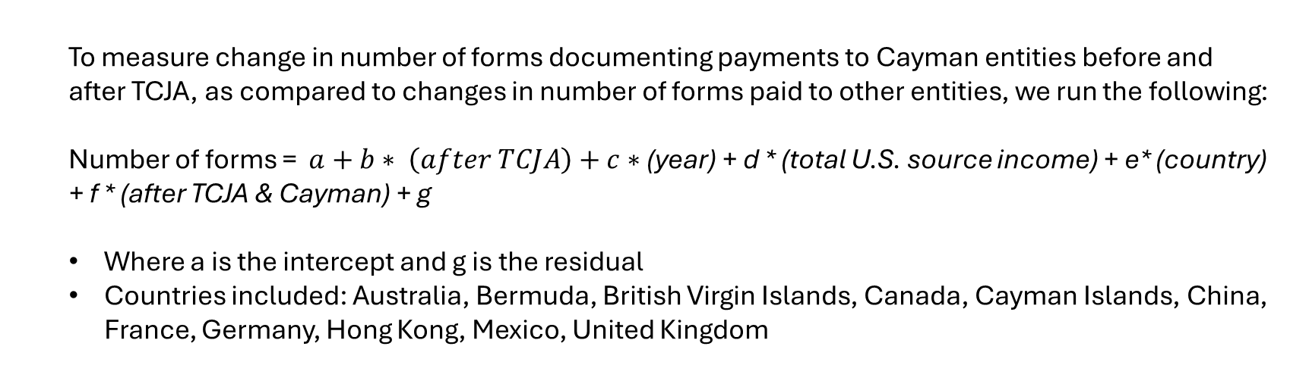
5. Forms 1042-S Results
To measure change in number of forms documenting payments to Cayman entities before and after TCJA, as compared to changes in number of forms paid to other entities, we run the following:
Number of forms = $a+b∗ \left(after TCJA\right)+c∗$(year) + d * (total U.S. source income) + e* (country) + f * (after TCJA & Cayman) + g
Where a is the intercept and g is the residual
Countries included: Australia, Bermuda, British Virgin Islands, Canada, Cayman Islands, China, France, Germany, Hong Kong, Mexico, United Kingdom

Slide 32
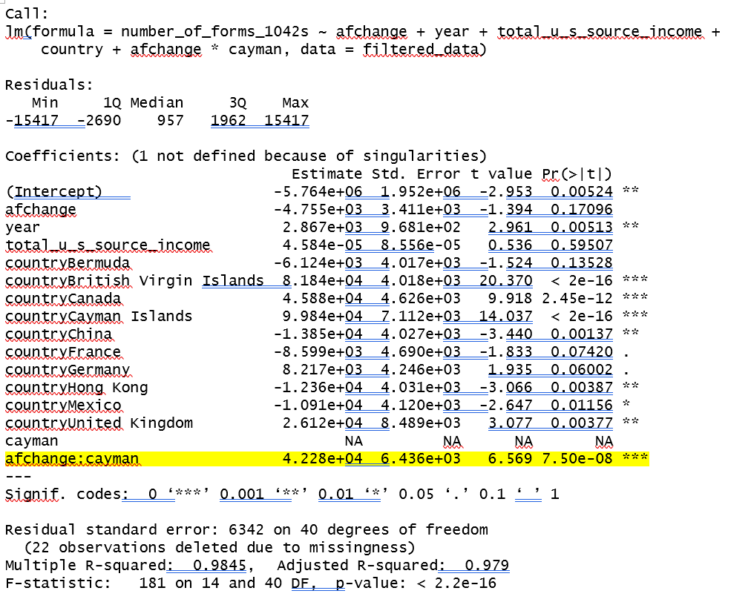
5. Forms 1042-S Results
Number of forms documenting payments to Cayman entities increased after TCJA

Slide 33
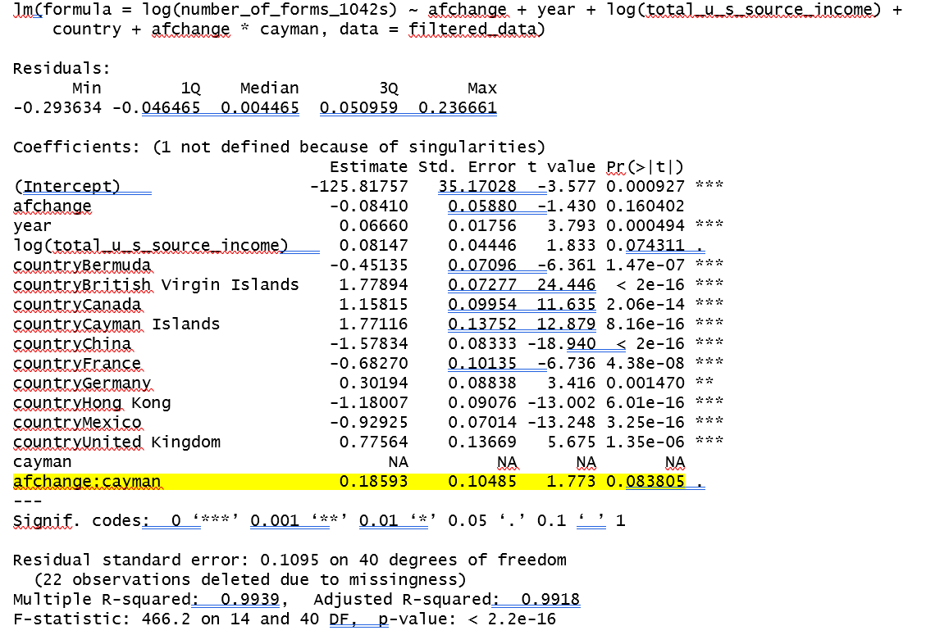
5. Forms 1042-S Results
However, statistical significance went away when the regression was run with log number of forms instead.

Slide 34
5. Forms 1042-S Results
Possible reasons for insignificance: in the post-TCJA structure, forms may be reported as issued to a Cayman partnership (e.g. if the Cayman partnership applied to be a withholding foreign partnership), or, rather, to the partners of the Cayman partnership. If the former, the number of forms to Cayman entities would not change before and after TCJA. In addition, data is not limited to type of industry or size of investment fund, which would impact number of borrowers and number (and size) of investors. My hypothesis would only be true for very large investment funds.

Slide 35
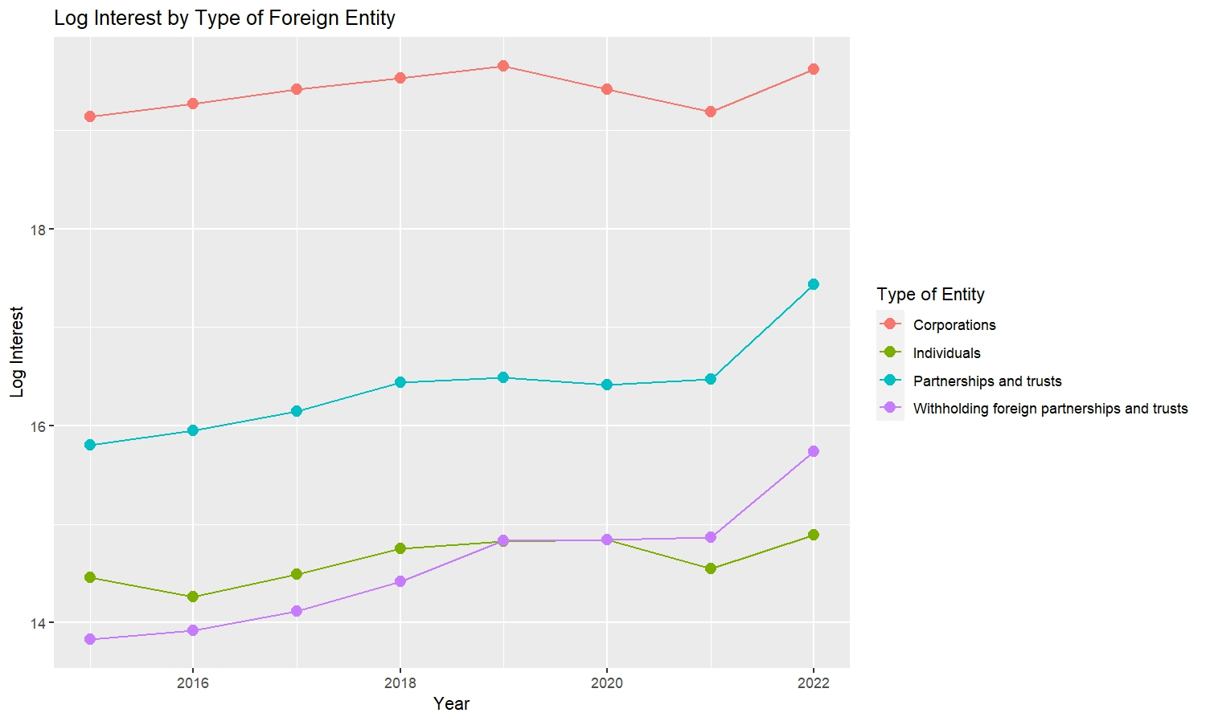
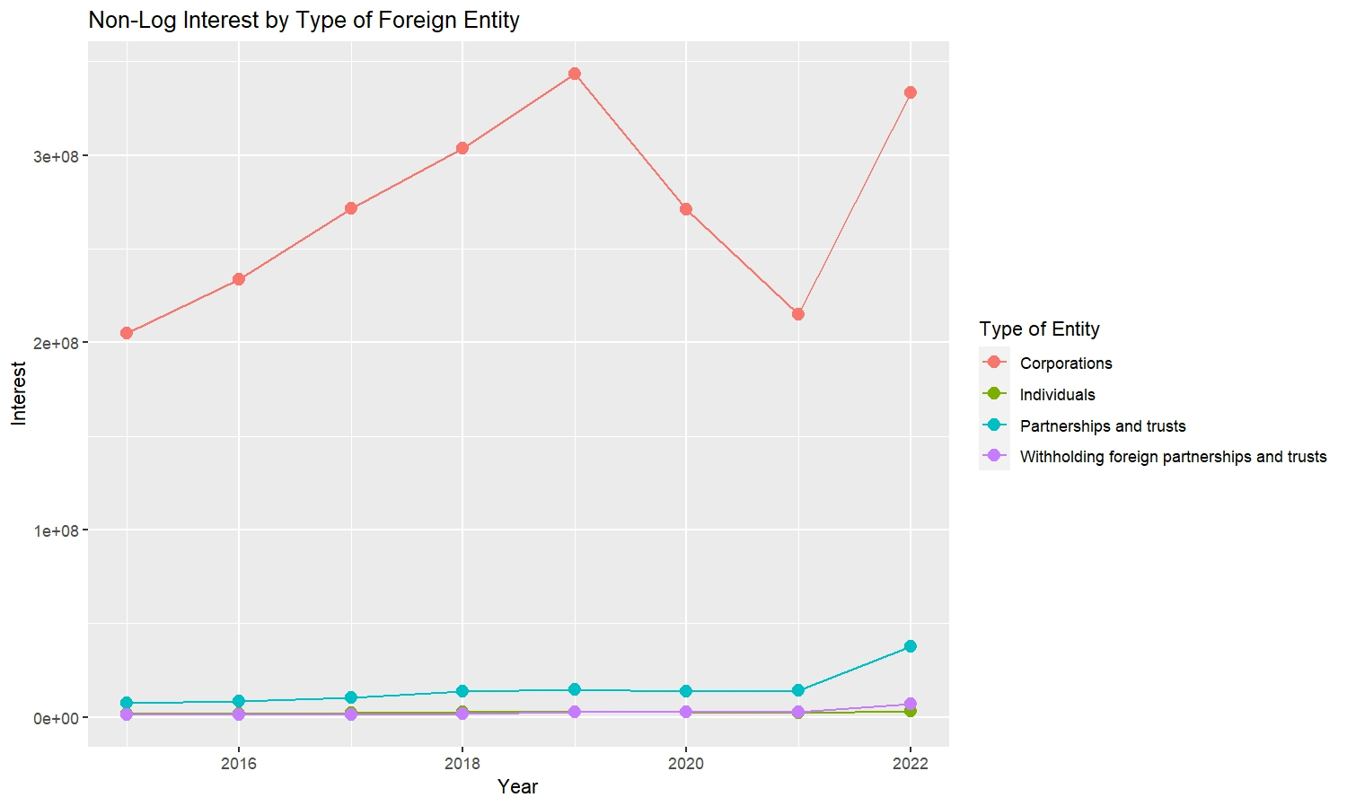
Foreign corporations receive most of the interest income

Slide 36
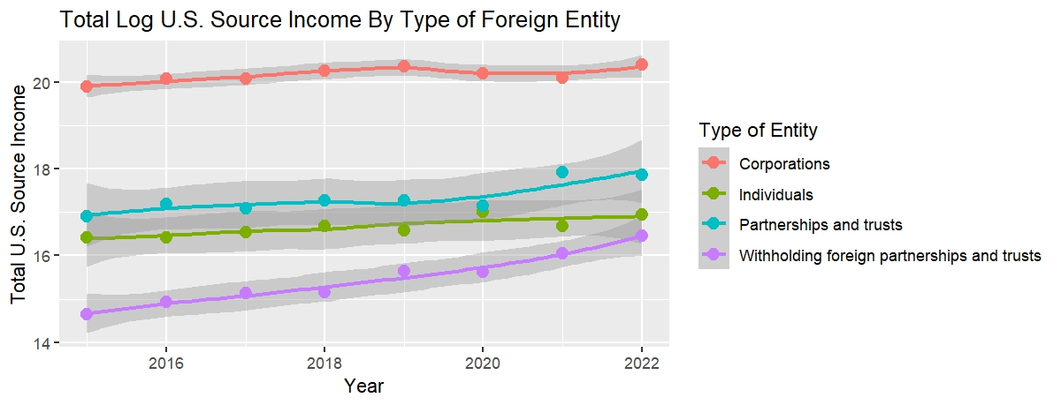
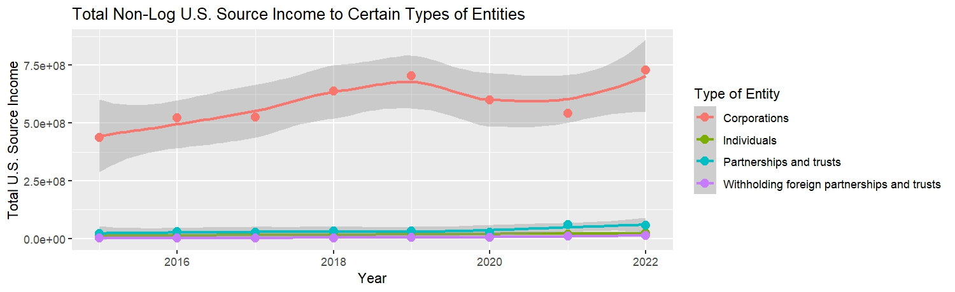
Foreign corporations also receive most of the U.S. source income, but withholding foreign partnerships’ share is increasing

Slide 37
Payments to withholding foreign partnerships
To see if number of forms documenting payments to withholding foreign partnerships changed after TCJA, as compared to payments to other types of entities, I also ran the following regression:
Log(number of forms 1042s) = a + b * (after TCJA) + c * year + d * (log (total U.S. source income)) + e * recipient type + f * (after TCJA & withholding foreign partnerships)
Forms for payments to foreign partnerships increased by e^59%=1.8x after TCJA, with statistical significance.

Slide 38
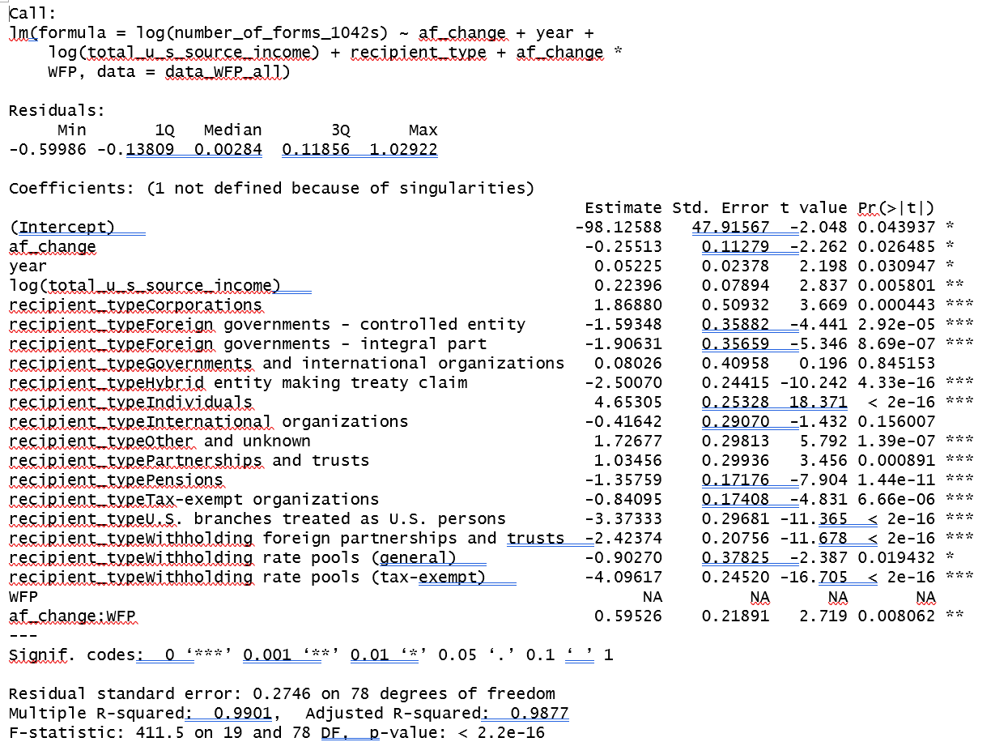
Payments to withholding foreign partnerships

Slide 39
Payments to withholding foreign partnerships
Larger investment funds can afford the personnel to make the withholding foreign partnership election and apply the withholding procedures. Increasing payments to withholding foreign partnership his may indicate that investment funds are increasing in size.

